Slide 1
Science
Parent workshop
Science Lead: Ms Beatrice Aina
Thursday 11th November 2021

Slide 2
Aims:
Workshop aims
What is primary science?
Our curriculum
Assessment
Engaging children and how we learn
Children’s work
Information on how to engage your children at home
Can you help us?

Slide 3
Science at primary school
What is Primary Science?
Children are naturally curious. Science at primary school nurtures this curiosity and allows children to ask questions and develop the skills they need to answer those questions.
Primary science helps pupils to:
Investigate problems.
Understand how science works.
Discover why science matters in the world.

Slide 4
Diverse Curriculum
Diversity
A diverse curriculum values children’s unique histories including their social, moral, religious and cultural backgrounds.
The links made between the children’s diversity, cultural capital and the curriculum are meaningful and build on the existing requirements of the National Curriculum.
Our science topics allow children to see how Science is integrated through everyday life and their diversities. As a school with children from different cultures and backgrounds, we aim to prioritise and cater to the needs of all our children.
This links to our possibilities driver, with the aim to provide children with a feeling that a career in Science is possible for anyone with an interest and one that they can achieve, whatever their background.

Slide 5
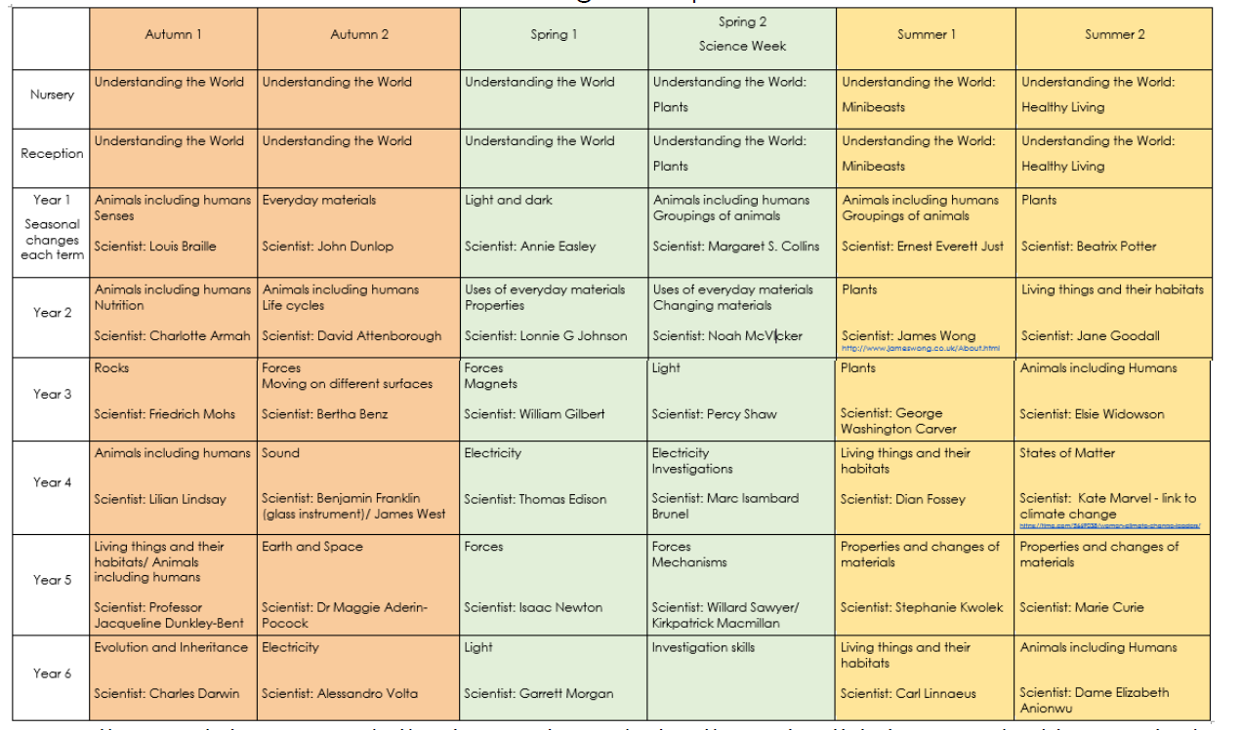
Curriculum overview
Curriculum
Map

Slide 6
Vocabulary
Science Vocabulary
Academic word list.
Topic specific.
Mapped out for each term.
Word of the week.

Slide 7
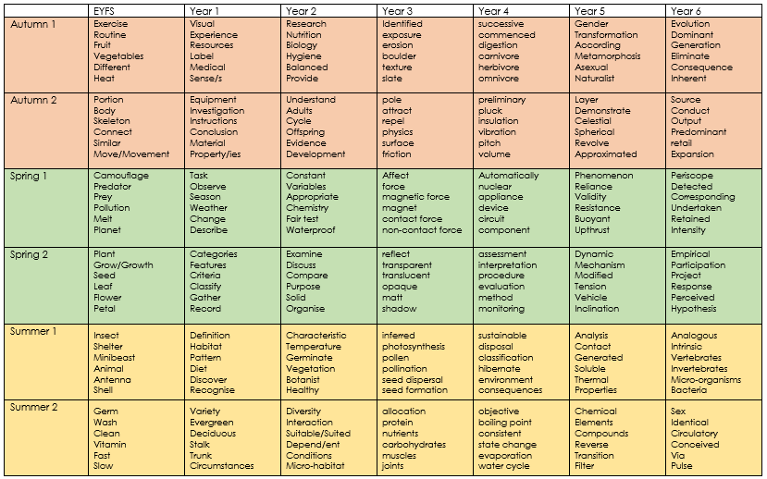

Slide 8
Engaging our learners
Curriculum structure
Hook lesson.
Key Scientists.
Practical investigations.

Slide 9
What does a Science lesson look like?
Lesson structure
A starter including the introduction of the word of the week.
Lesson Learning Objective and Steps to Success (how will they achieve the learning?).
Prior learning/previous knowledge links.
Skills and knowledge input.
Differentiated activity/task/Investigation.
Plenary.

Slide 10
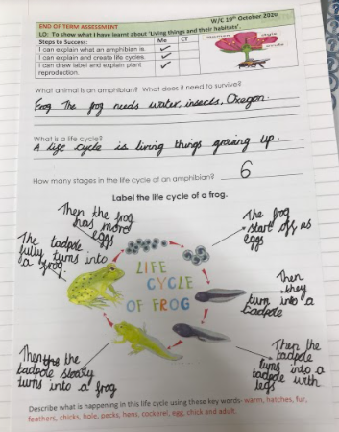
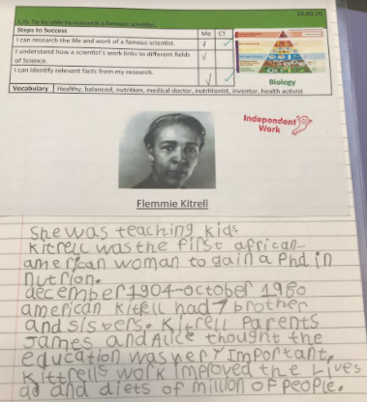
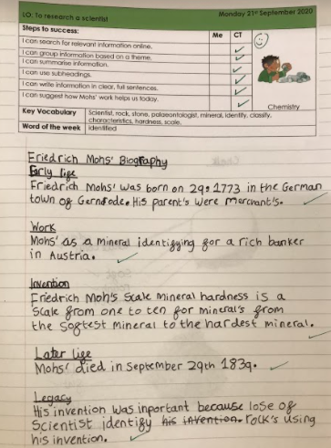
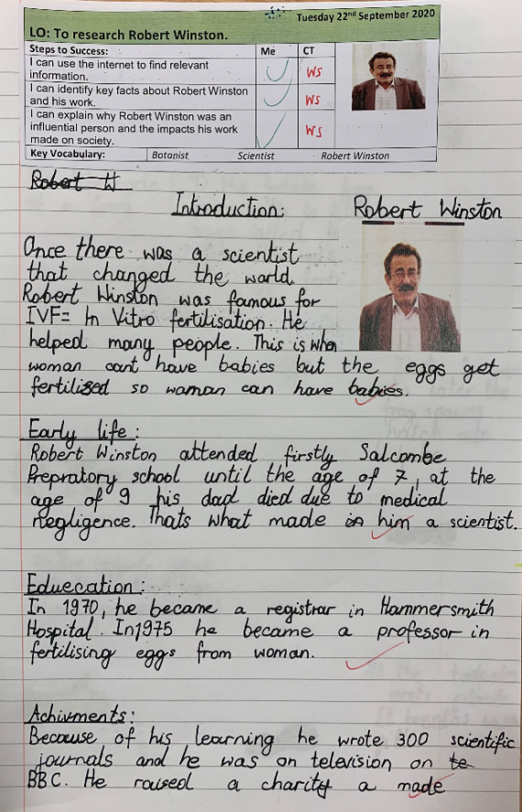
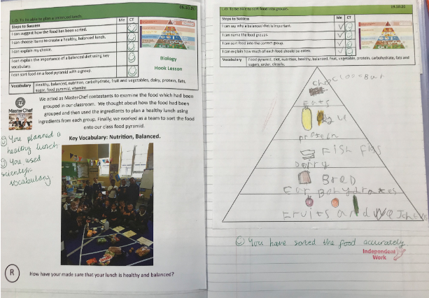
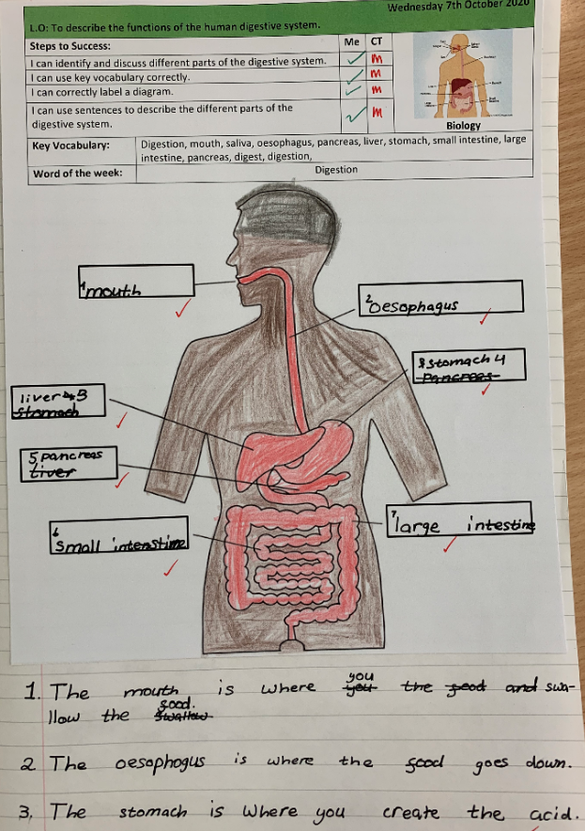
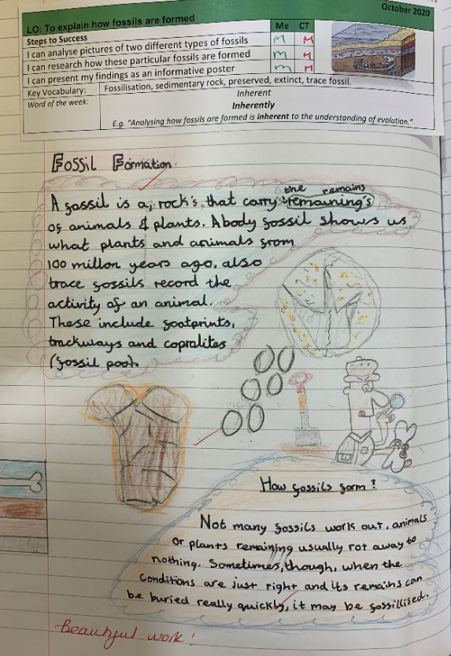
Science work

Slide 11
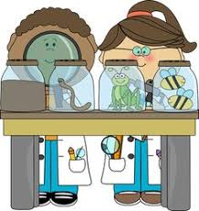
Enquiry-based approach
Investigations
Teaching science through an enquiry based approach allows children to apply knowledge and skills practically.
Children develop questions to deepen their understanding.
Each unit includes 2 practical investigations. These cover the working strategically skills listed in the National Curriculum.
Investigations are recorded using the investigation proformas:

Slide 12
Investigations

Slide 13
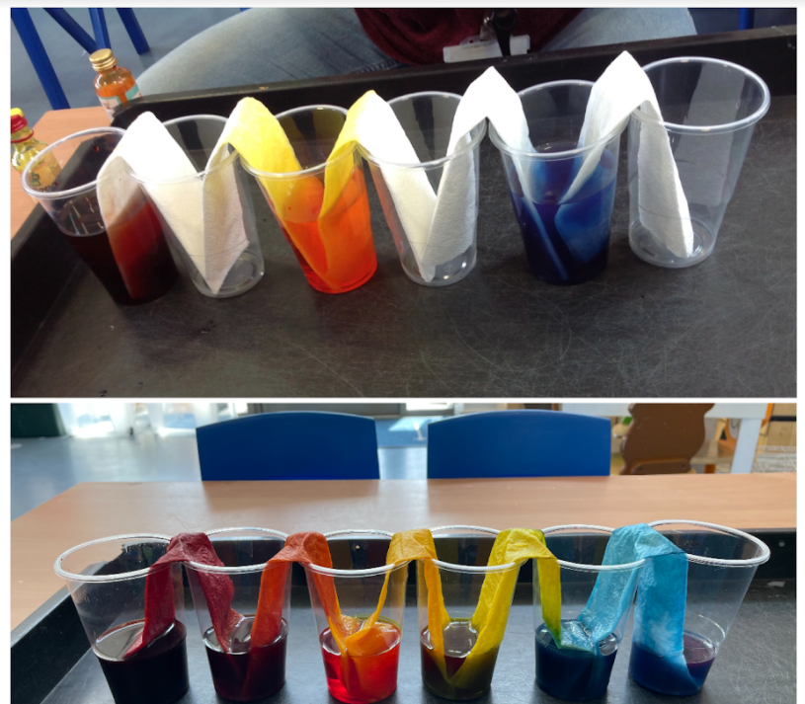
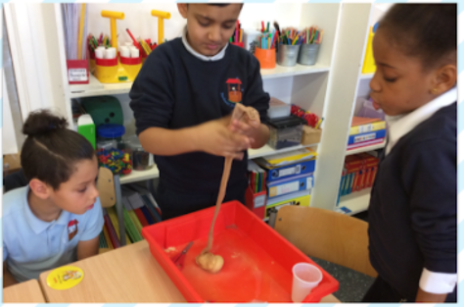
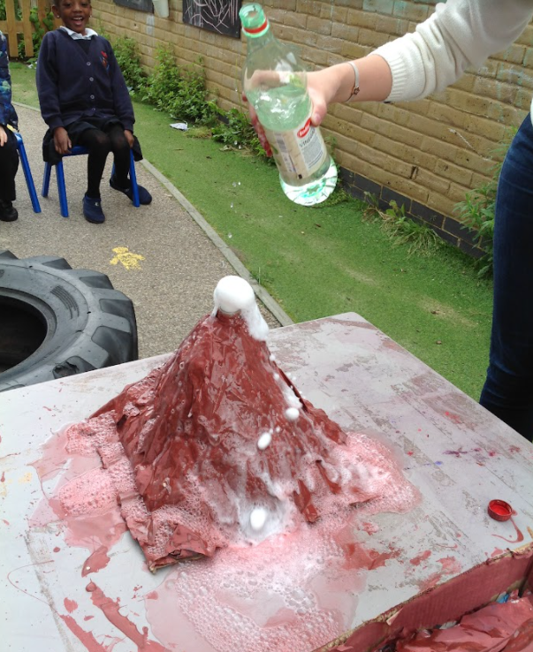
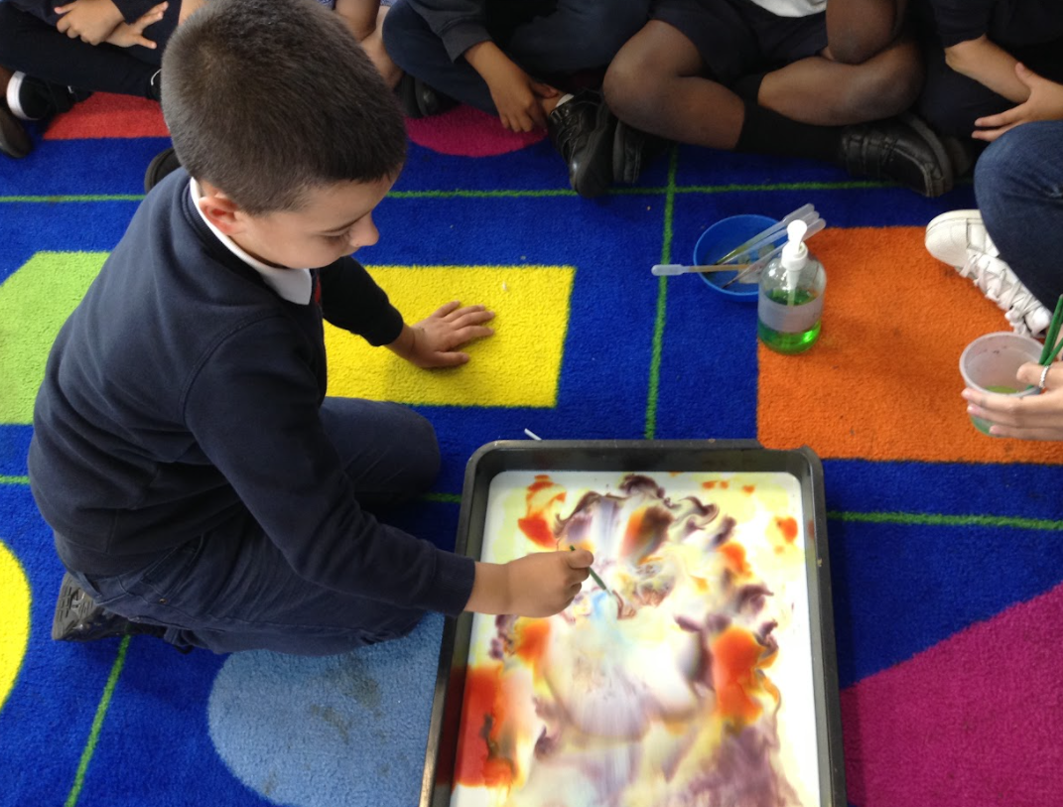
Investigations

Slide 14
Assessment
Assessment
Assessment of science is an ongoing process through each unit in line with the
national curriculum statements. Lessons are planned to allow for assessment to be made against all national curriculum points andalso for assessment of new vocabulary teaching.
Where a word of the week is introduced teachers ensure that children have an opportunity to use it in their writing and discussions.
Summative assessment is entered on the schools’ assessment tool (Classroom Monitor) at the end of each half term.

Slide 15
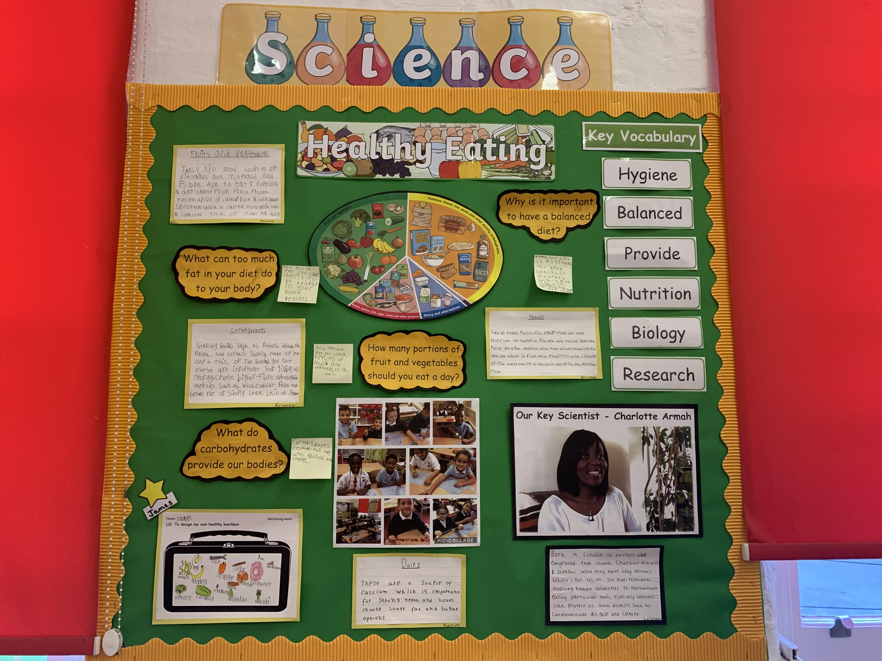
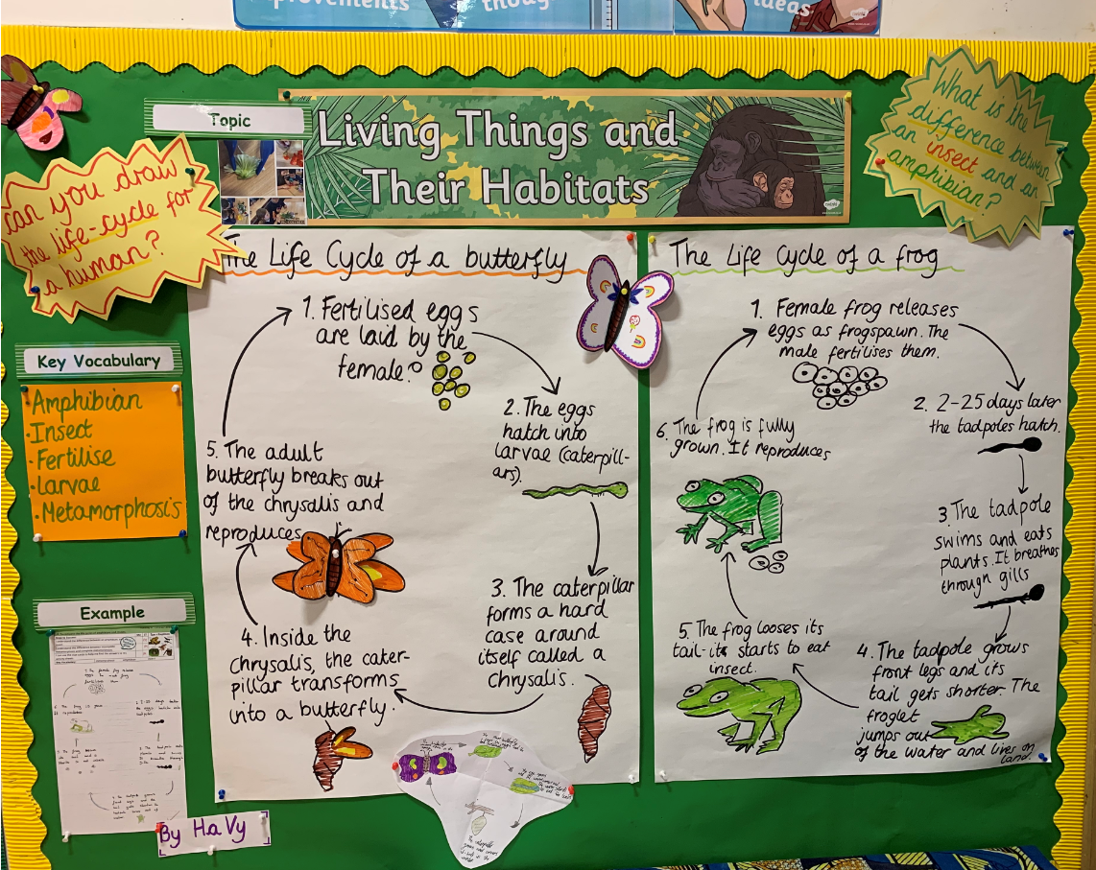
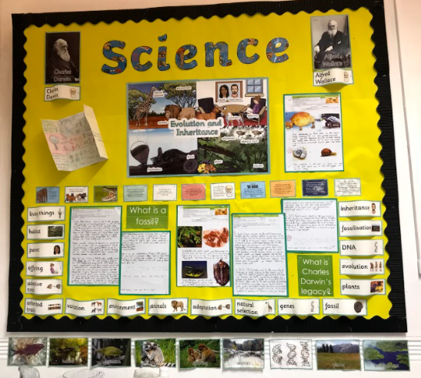
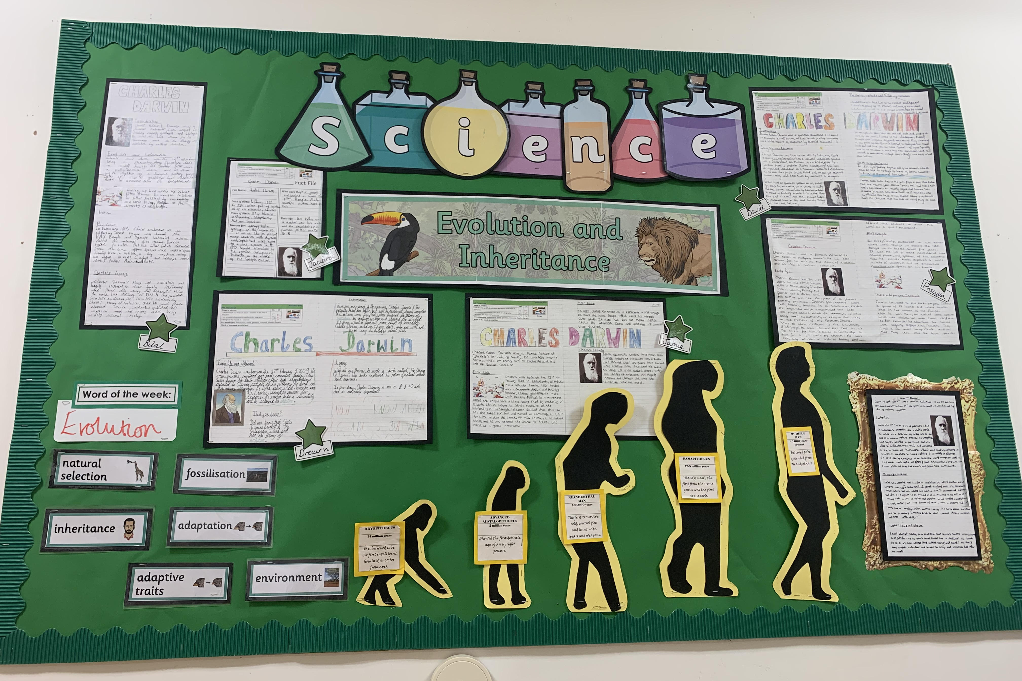
Science displays

Slide 16
Useful links
Resources
Some websites to support Science at home…
https://www.stem.org.uk/home-learning/primary
Free activities and materials put together by subject experts.
https://explorify.wellcome.ac.uk/blog/explorify-during-school-closures
A set of collections of activities based on the primary Science curriculum to do at home.
http://www.show.me.uk/section/science
Science and technology games, collection objects, homework help and more from museums and galleries.
https://pstt.org.uk/resources/curriculum-materials/Science-Fun-at-Home
Simple and engaging practical science activities.
https://www.bbc.co.uk/bitesize/primary
Videos, quizzes and practical activities to do at home.

Slide 17
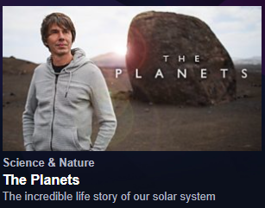
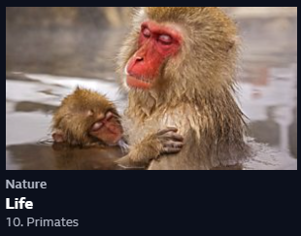
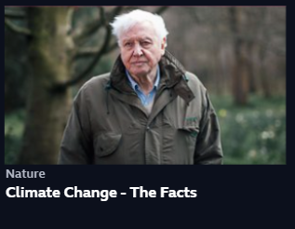
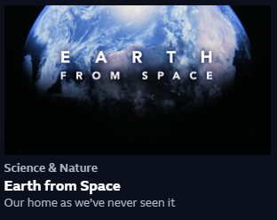
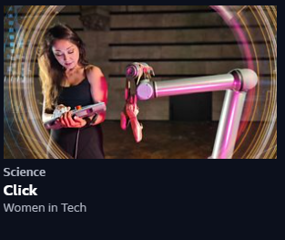
Useful links
Resources
Why don’t you have a look at some of these iplayer links to further your science learning at home…
These and more can be found on...
https://www.bbc.co.uk/iplayer/categories/science-and-nature/a-z

Slide 18
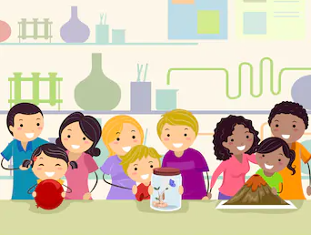
Can you help us?
Parent helpers
Do you have a science background?
Do you work in a field of science?
Do you know someone who does?
We would love to build some links with parents to further our possibilities driver and give children context for their learning.
If you have a background in any field of Science and would be willing to talk to one of our year groups about what a job in Science entails please email the school office.
We will be looking for anyone who can talk about a career in Science to talk at various points through the year, including during Science Week in March 2022.

Slide 19
Any questions?
Thank you for your time, please take a few minutes to complete the evaluation form.

