Slide 1

Understanding Com-Networks: Keeping Children Safe Online
Introduction
Com-Networks are an increasing safeguarding threat, posing significant risks to the safety of children online.
What are Com-Networks?
Online communities operating on closed platforms such as Discord. The most commonly-referenced group is 764, and others include No Lives Matter, Order of Nine Angles and CVLT.
These groups manipulate young people into livestreaming themselves committing violence or self-harm, and host violent, terrorist, and illegal sexual content on their platforms to desensitise young people.
Who is Most at Risk?
All young people may be vulnerable. Some young people who are neurodivergent may be more susceptible.
Levels of Harm
False reporting of victims to authorities and Harassment
Animal Abuse
Self-Harm (Cutting names into the body, suicide)
Indecent images of children
Sextortion (Gaining sexual photos for further extortion)
Terrorism (possession of terrorist content, bomb-making, etc).
Recent UK Convictions of 764 users
Cameron Finnigan – 19yrs old
Finnigan, from West Sussex, was sentenced to six years in prison for encouraging an Italian girl to livestream her suicide. He was also found guilty of possessing terrorist manuals and of possessing indecent images of children.
Vincent Charlton – 17yrs old
Charlton, from Gateshead, was sentenced to 28 months in prison for creating and possessing indecent images of children and possessing terrorist manuals. On his devices, police found video of a young girl cutting his name into her body along with documents on bomb-making.
Warning Signs
Changes in Behaviour
Reluctance to allow parents to look at devices
Rapid decline in mental health and increased isolation
Increased secretive behaviour
Online
The use of unusual symbols
Signs young people are being pressured to join other platforms
Downloading of unusual messaging apps e.g. Telegram
Using (or having contact with) profiles with few/no pictures and followers
What Can You Do?
Remain calm and supportive whilst finding out more
Visit ACT Early site for helpful tips: https://actearly.uk/advice/tips-for-talking/
Report harmful accounts to the platform
Contact prevent@Lambeth.gov.uk if concerned about an interest in mass-casualty violence or engagement with extremist/terrorist material
Contact police on 999 if concerned about immediate serious harm
Further resources
https://www.bbc.co.uk/news/articles/c2dn91z3e2ko
https://www.parents.com/764-is-the-latest-online-threat-targeting-your-tween-11742468

Slide 2
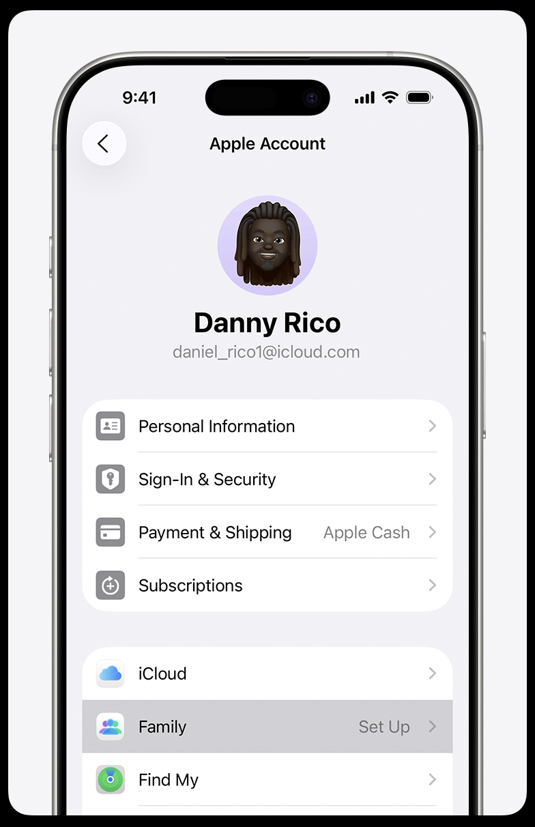
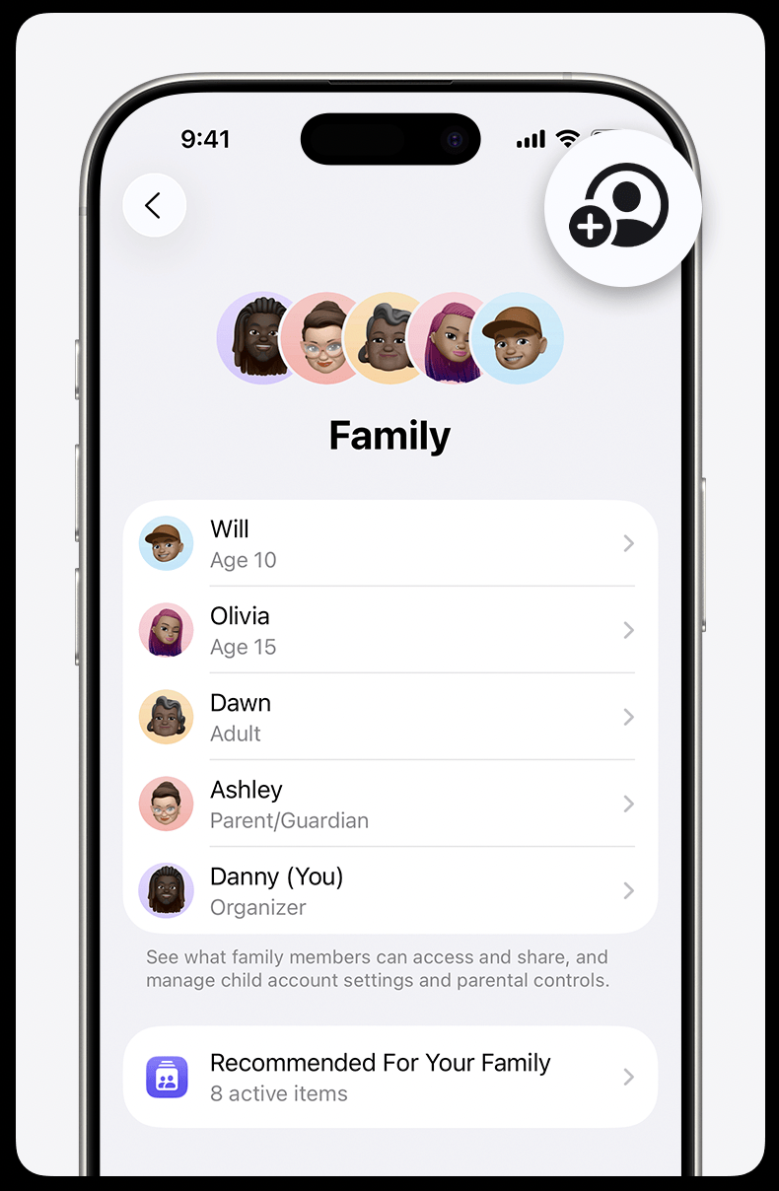
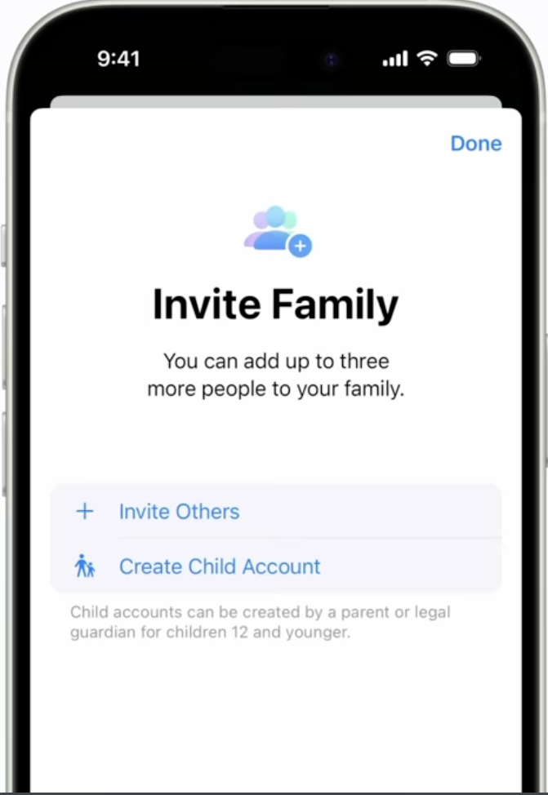
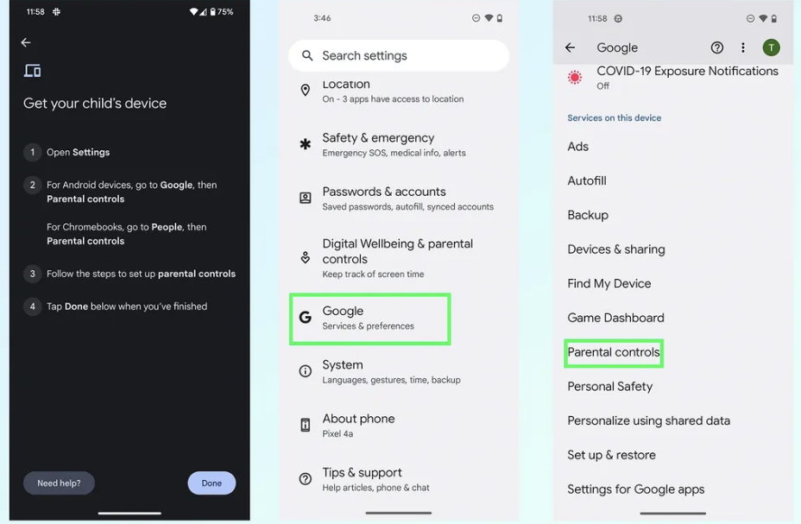
Understanding Com-Networks: Keeping Children Safe Online
Parental Controls
Free built-in family tools on iPhone and Android help parents keep children safe online, not just restrict screen time.
Features
Google’s Family Link or iPhone Family Centre allow you to connect your phone to your child’s and set up controls. You will receive a notification whenever your child wishes to download a new app. This gives you the opportunity to have a conversation with your child about why they feel they are ready for the app and how they can they stay safe on there .Tips on conversations https://www.nspcc.org.uk/keeping-children-safe/online-safety/talking-child-online-safety/)
Apple Family Share steps
On parent’s device, open settings -> Name -> Family -> Add -> create child account
Add child’s name and birthday -> review terms and conditions -> click agree -> add child’s existing iCloud email
If child doesn’t have an iCloud email, create one when prompted on screen -> create password both you and your child will remember -> enter your mobile number
Follow onscreen instructions to set up desired parental controls -> choose passcode to enter parental controls in the future
Set up is now done for both devices
For more help on installing and using Family Sharing
https://www.youtube.com/watch?v=8siFNH-brM4
https://www.apple.com/uk/family-sharing/
https://support.apple.com/en-gb/108380
Google Family Link steps
On child’s device, open settings -> Google -> All Services -> Parental Controls
Choose account you wish to supervise (create a google account for your child if they don’t have one yet) -> click next
Enter parent email -> enter child’s account password -> click allow
Set up on child’s device is now done
On parent’s device, download FamilyLink -> enter parent email -> click continue
Set up on parent’s device is now done
For more help on installing and using FamilyLink
https://www.youtube.com/watch?v=AQRDLBrWr0E
https://www.tomsguide.com/how-to/how-to-set-up-parental-controls-on-android-with-google-family-link
https://support.google.com/families/answer/7101025?hl=en
Workshop Events with Lambeth Council
Join our next online safety workshop on March 16th: https://buytickets.at/communitysafety/1426503
Check age requirements and safety info for popular apps like WhatsApp, TikTok, Discord and Telegram here: https://www.internetmatters.org/advice/apps-and-platforms/

